Slide 1

Course Overview
Online Cryptography Course Dan Boneh
Introduction

Slide 2
Welcome
Course objectives:
Learn how crypto primitives work
Learn how to use them correctly and reason about security
My recommendations:
Take notes
Pause video frequently to think about the material
Answer the in-video questions

Slide 3
Cryptography is everywhere
Secure communication:
web traffic: HTTPS
wireless traffic: 802.11i WPA2 (and WEP), GSM, Bluetooth
Encrypting files on disk: EFS, TrueCrypt
Content protection (e.g. DVD, Blu-ray): CSS, AACS
User authentication
… and much much more

Slide 4
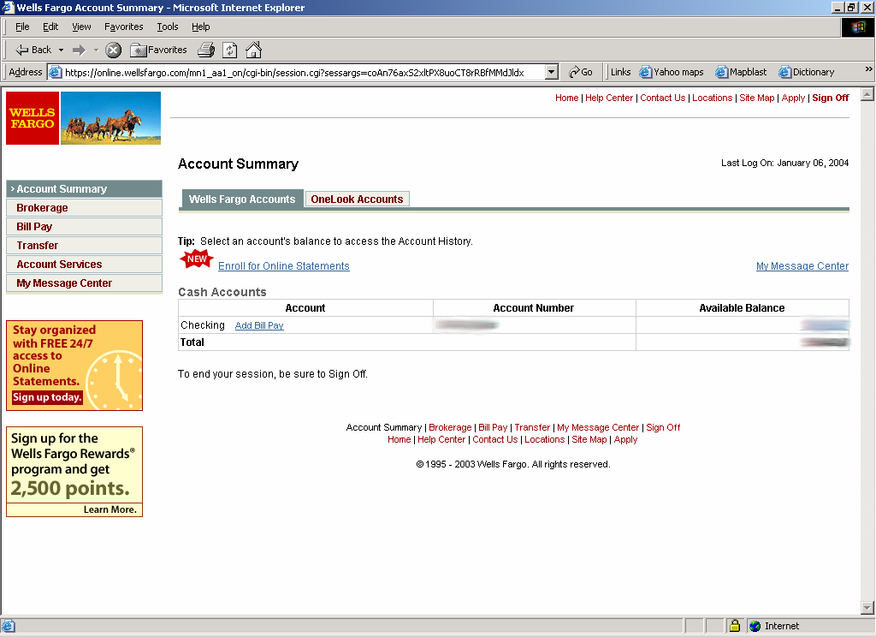
Secure communication
no eavesdropping
no tampering

Slide 5
Secure Sockets Layer / TLS
Two main parts
1. Handshake Protocol: Establish shared secret key using public-key cryptography (2nd part of course)
2. Record Layer: Transmit data using shared secret key
Ensure confidentiality and integrity (1st part of course)

Slide 6
Protected files on disk
Disk
File 1
Alice
Alice
No eavesdropping
No tampering
File 2
Analogous to secure communication:
Alice today sends a message to Alice tomorrow

Slide 7
Building block: sym. encryption
E, D: cipher k: secret key (e.g. 128 bits)
m, c: plaintext, ciphertext
Encryption algorithm is publicly known
Never use a proprietary cipher
Alice
Bob
m
E
E(k,m)=c
c
D
D(k,c)=m
k
k

Slide 8
Use Cases
Single use key: (one time key)
Key is only used to encrypt one message
encrypted email: new key generated for every email
Multi use key: (many time key)
Key used to encrypt multiple messages
encrypted files: same key used to encrypt many files
Need more machinery than for one-time key

Slide 9
Things to remember
Cryptography is:
A tremendous tool
The basis for many security mechanisms
Cryptography is not:
The solution to all security problems
Reliable unless implemented and used properly
Something you should try to invent yourself
many many examples of broken ad-hoc designs

Slide 10
End of Segment

